Slide 1
An O(n log n) algorithm for the all-farthest-segments problem for a planar set of points
R.L. Scot Drysdale, Asish Mukhopadhyay
Information Processing Letters 105 (2008) 47–51
Speaker: Chun-Jen Chen
Date: Apr. 17, 2008

Slide 2
Abstract
In this paper, we propose an algorithm for computing the farthest-segment Voronoi diagram for the edges of a convex polygon and apply this to obtain an O(n log n) algorithm for the following proximity problem: Given a set P of n (>2) points in the plane, we have O(n²) implicitly defined segments on pairs of points.
115/11/07

Slide 3
Abstract
For each point p ∈ P, find a segment from this set of implicitly defined segments that is farthest from p. We improve the previously known time bound of O(nh+n log n) for this problem, where h is the number of vertices on the convex hull of P.
115/11/07

Slide 4

All-Farthest-Segments problem
115/11/07

Slide 5

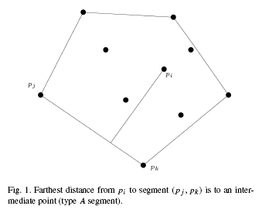
Lemma 1.
115/11/07

Slide 6


Lemma 2.
115/11/07

Slide 7
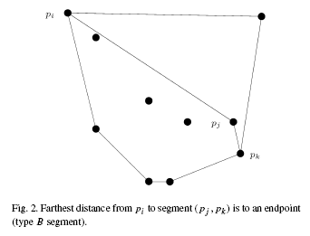
Lemma 2.
115/11/07

Slide 8
O(h) + O( log(n-h) ) + O(h)
Previous time: O( nh + nlogn )
115/11/07

Slide 9
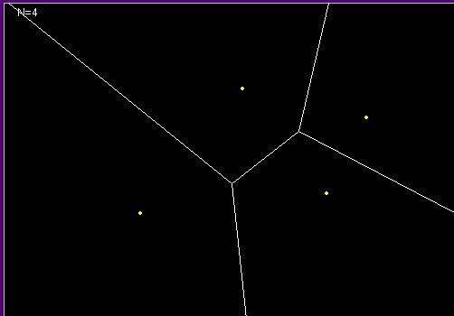
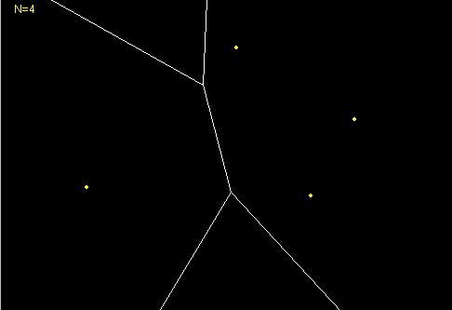
Voronoi
Voronoi Farthest-point Voronoi
115/11/07

Slide 10
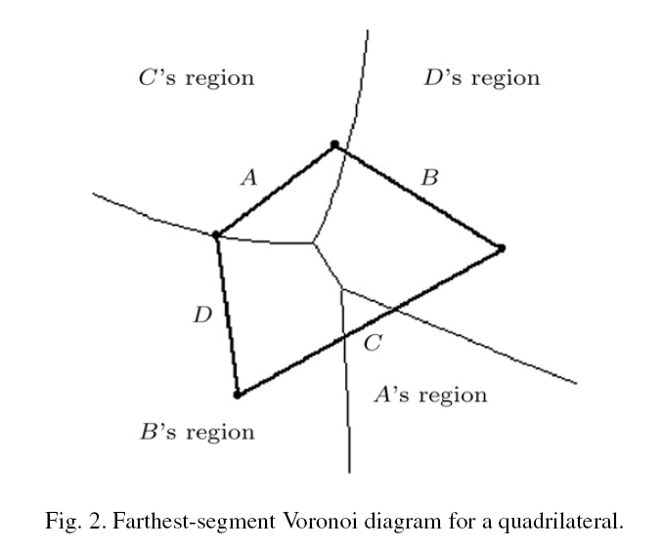
Farthest-Segment Voronoi
115/11/07

Slide 11
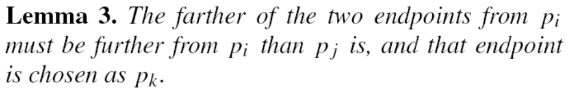
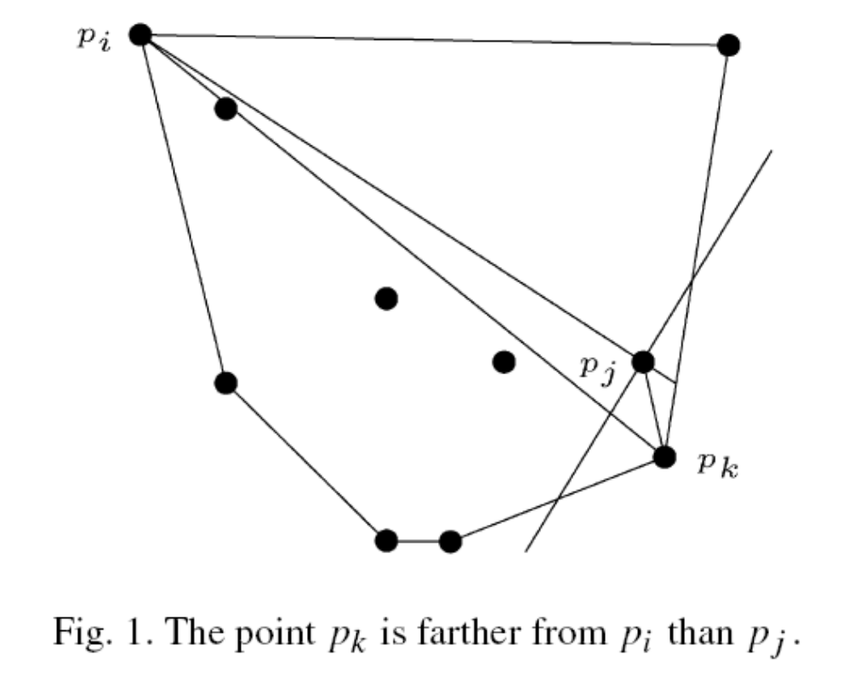
Lemma 3.
115/11/07

Slide 12
Lemma. 3
Because the convex hull is a convex polygon, we can use binary search to find the intersection of the ray and the convex hull. This takes O(log h) time.
115/11/07

Slide 13
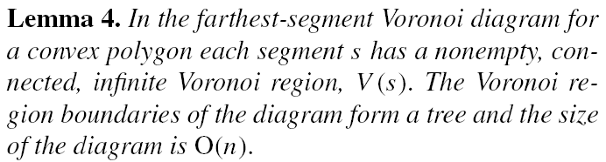
Lemma. 4
115/11/07

Slide 14
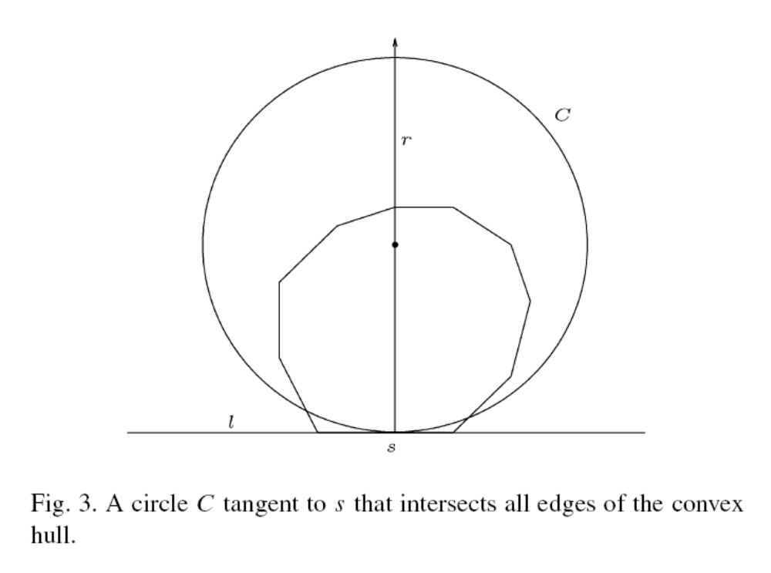
Lemma. 4
115/11/07

Slide 15
Lemma. 4
A connected boundary with no finite regions can have no cycles, so must be a tree. The diagram is a planar graph and the bisector between two segments contains a constant number of curves. From these facts we can conclude that the diagram has size O(n).
115/11/07

Slide 16
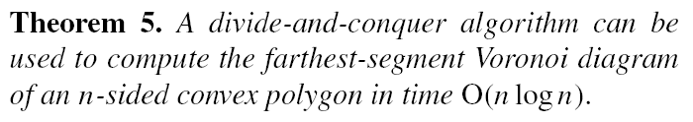
Lemma. 5
115/11/07

Slide 17
Algorithm
Preprocessing:
1. Convex Hull
2. Farthest-Point Voronoi of points interior to
Convex polygon
3.Farthest-Segment Voronoi of Convex polygon
Step 1. locate point p_{i} in the Farthest-Point Voronoi
Step 2. find a convex vertex p_{k} farther than p_{j}
Step 3. locate point p_{i} in the Farthest-Segment Voronoi
115/11/07

